Slide 1
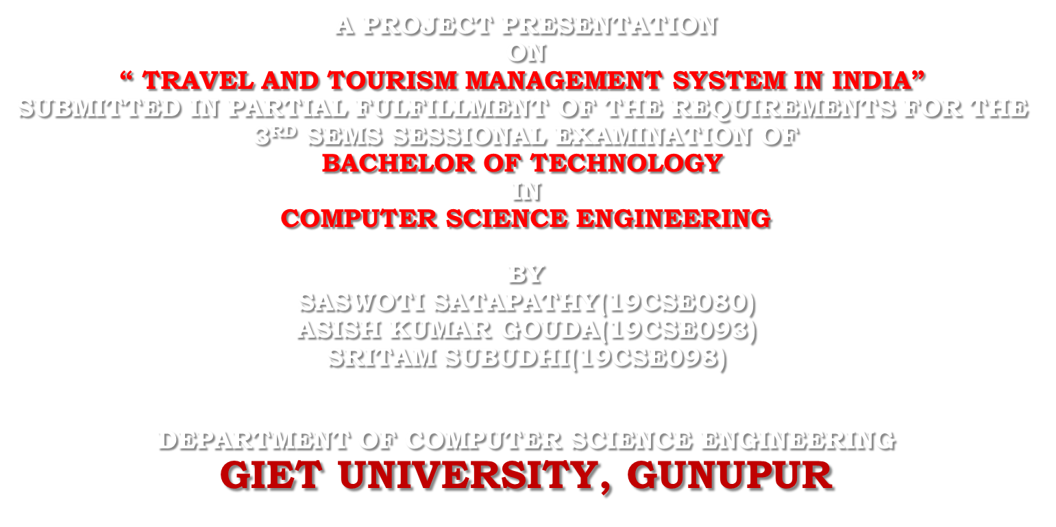


Slide 2
INTRODUCTION
Tourism can be considered as most favourite pass time when people get free time. Tourist are considered as one of the important asset of our country, it helps in economy growth of one’s country. The travel companies concentrate on the interest associated with tourist making sure to increase their particular market value and supply enormous package deals. Now-a-days there are many travel packages existing from different websites to almost all the places over the world. A customer finds it very difficult to search for the best package as he/she has to browse multiple websites, contact many travel agents and etc, which is a tedious process and is time consuming. There should be a system where the user should find the best package on the Internet with a single click. It is as well very difficult because most of the reviews present on the web is biased.

Slide 3
To address this issue, we adopt Travel Management System which offers the best package among all the other packages . This project will help tourist to suggest the best Travel Package among all the package . The most attracting point of our concept is that one can operate or use this without using browser. One can easily retrieve , insert and manipulate the details and can upgrade according to their convenience.

Slide 4
IMPORTANCE AND NEED OF PROJECT
As you all know that vital success and development of many economies. Tourism boosts the revenue of the economy, creates thousands of job and improves infrastructure. It contributes a lot in the development of National GDP and employment.
It is important to understand that the tourist industry is linked to movement to different locations not only on leisure but also business and some additional travel motivators. So there is a need of good travel system that can be accessed easily while booking.
The whole world has moved online so it is obvious that there are many network problems occurring during bookings , so there must be a system/ software that deals with the same.
Due to server errors the tourists face a lot of problems during the tour, there can be mismatching of the data entered and the data stored .
This tool is applied easily to coordinate between the travel lovers and the service providers.

Slide 5
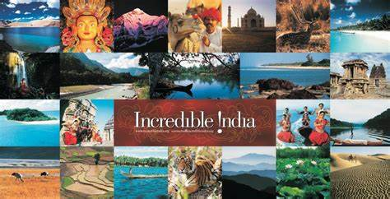
6.Customers can easily use this software , select the service they would like to book and fill up the booking form according to the instructions . 7. To remain competitive and profitable travel agencies enhance their client’s experiences pre-judicially. 8.Choosing an online booking system that meets all your needs is a stressful job.

Slide 6
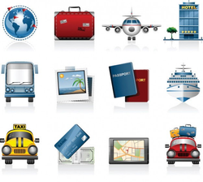
OBJECTIVES
1.Our first objective is to ensure that people are able to easily access the page.
2. We ensure that one can do complete bookings even without internet access because people having poor network face a lot during online bookings and payments.
3. To cut down the commissions taken by travel agents during online payments.
4. To decrease the number of online fraud sites.
5. Every travel package consists of many landscapes (places of interest and attractions), and thus has intrinsic complex spatial temporal relationship .

Slide 7
WORKING PRINCIPLES AND METHODOLOGY
The concept we had used in our project is Menu Driven programs. A program that obtains input from the user by displaying a list of options –the menu-from which the user indicates his/her choices.
Menu driven programs are advantageous in two ways:
Firstly because input is via single strokes, the system is less prone to user error; secondly, because only a limited range of characters are allowed the way in which the input is to be entered is unambiguous. This contributes in making the program more user friendly.

Slide 8
HARDWARE AND SOFTWARE REQUIREMENTS
SOFTWARE:
1. Language : C and C++
2. Version : Turbo C++ 3.2
3. IDE : Turbo C++
HARDWARE:
1. PC: windows XP and above
2. Processor : AMD Ryzen 3 or Intel Core i3 and above
3. Hard disk: 2.50Hz
4. RAM: 4GB

Slide 9
DESIGN AND DEVELOPMENT
The Software product is designed for PC, laptops and all devices which are compatible with Turbo C . The users of this product can use the services of the software as data is retrieved and stored in Turbo C database and mined to get the results. The product is compatible with c language and CPP.
CPP is a source file , compiled with a C++ compiler , all the code in it is compiled as C++ code. CPP files must be compiled by a C++ compiler for the target platform before the code can be run.
The Bharat Travels was developed using Turbo C++ in Windows 10 . There is no web-based application required .
Once the user open the page it shows the welcoming page then it asks the user to press any key to continue.

Slide 10
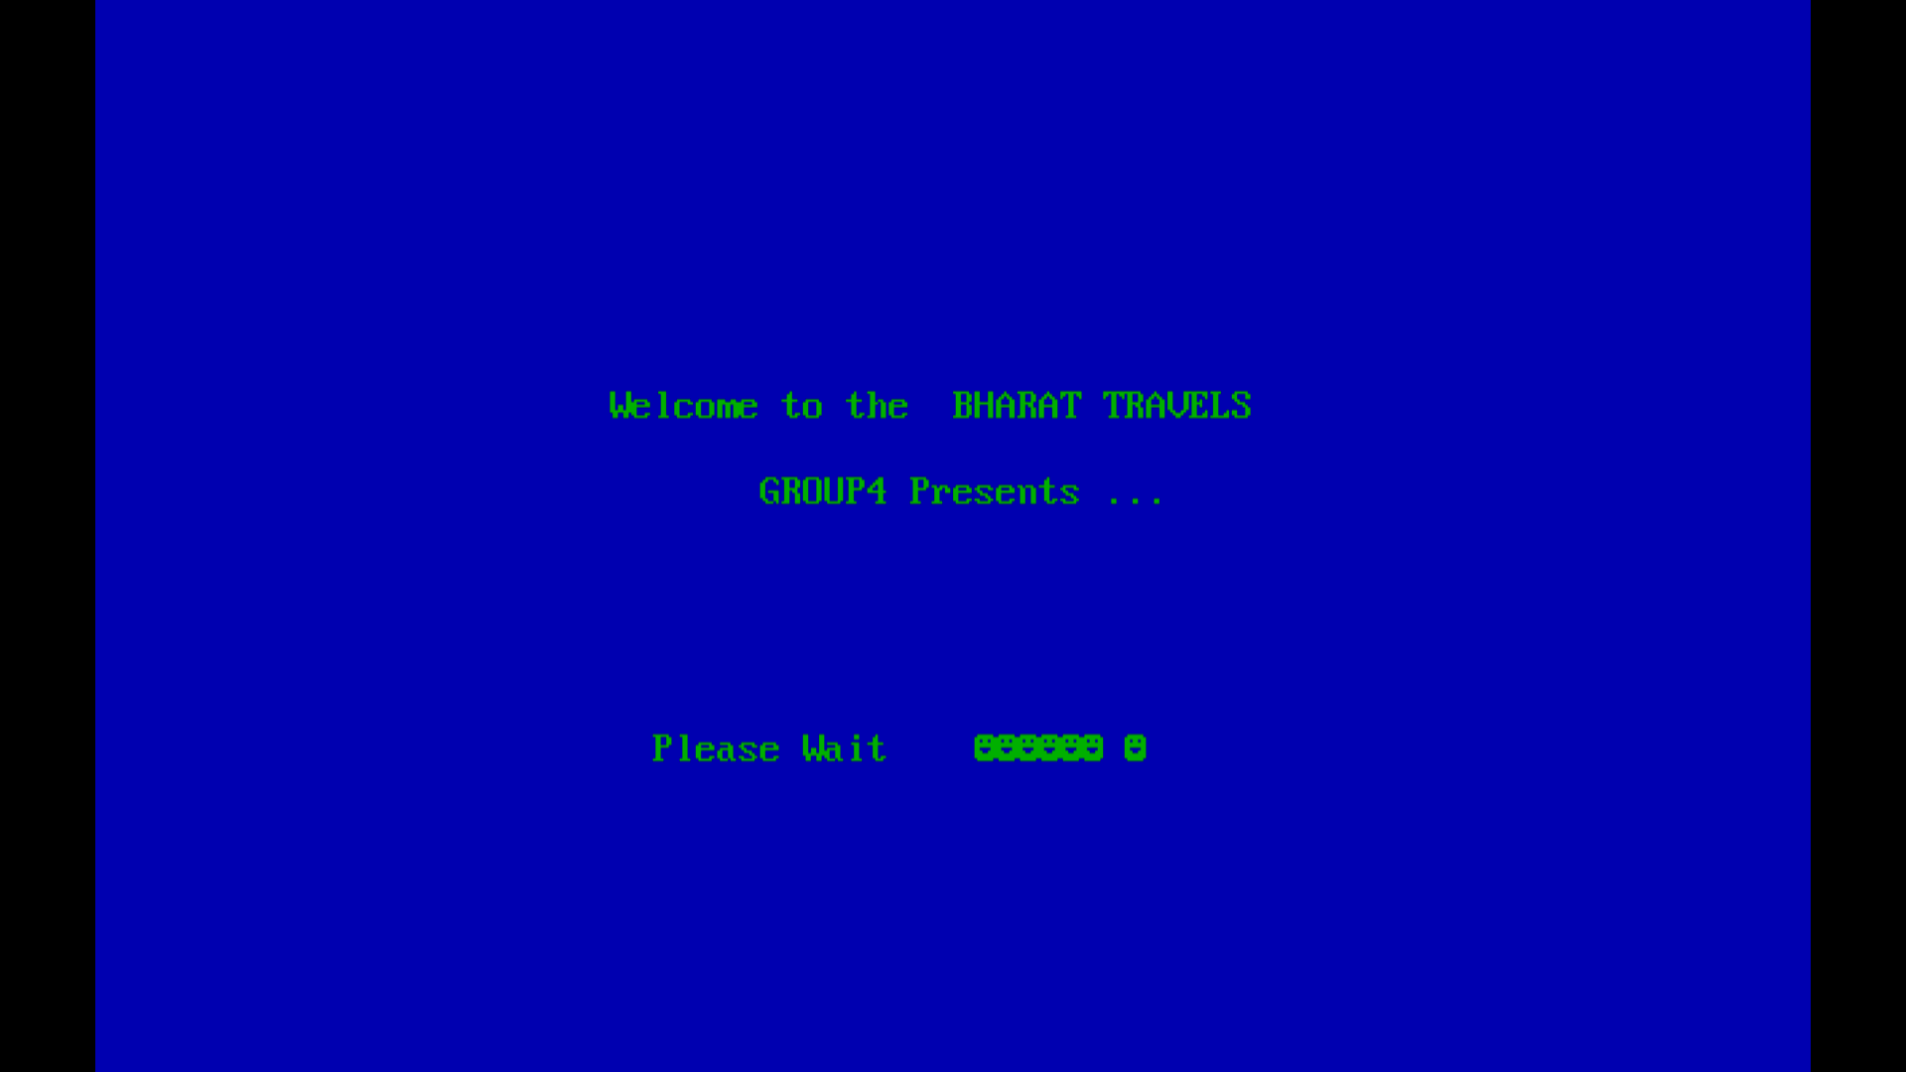
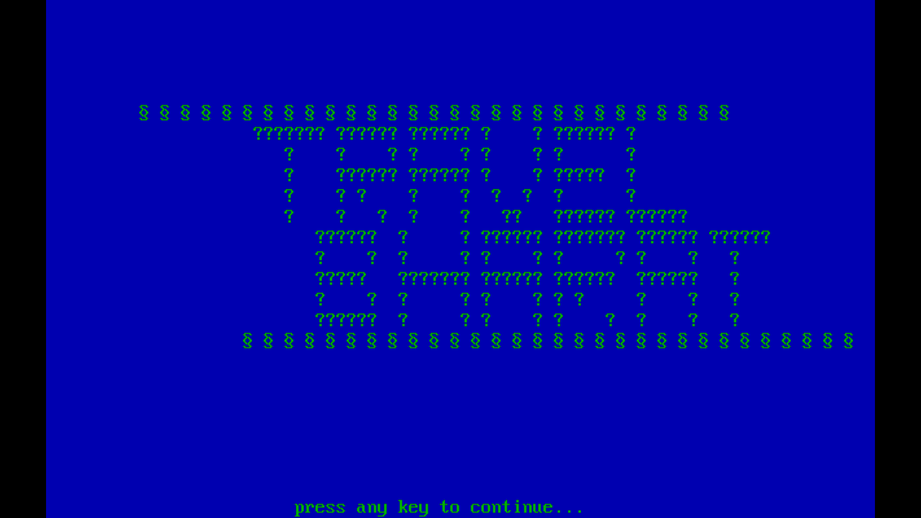
SCREENSHOTS
WELCOME PAGES

Slide 11
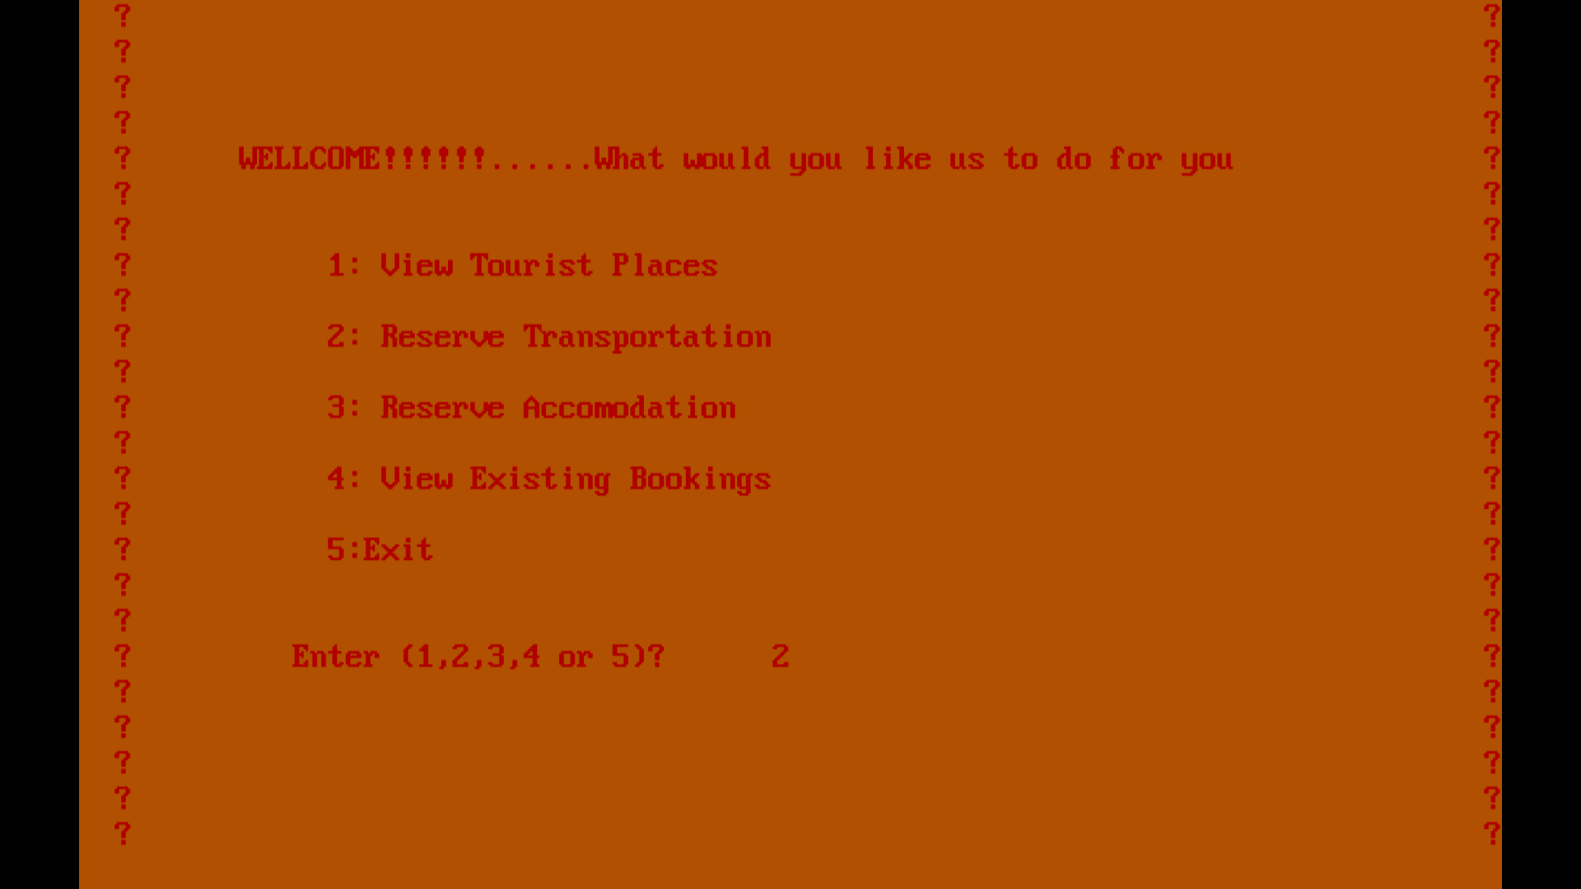
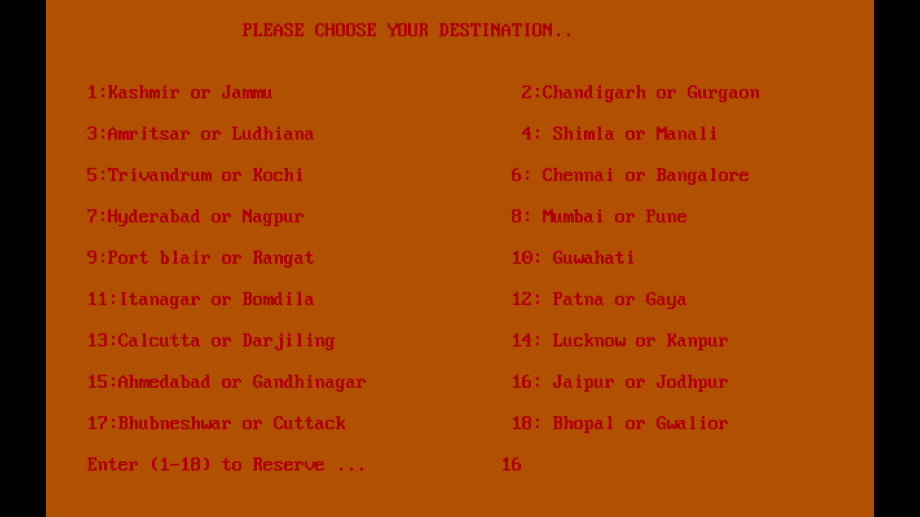
HOME PAGE

Slide 12
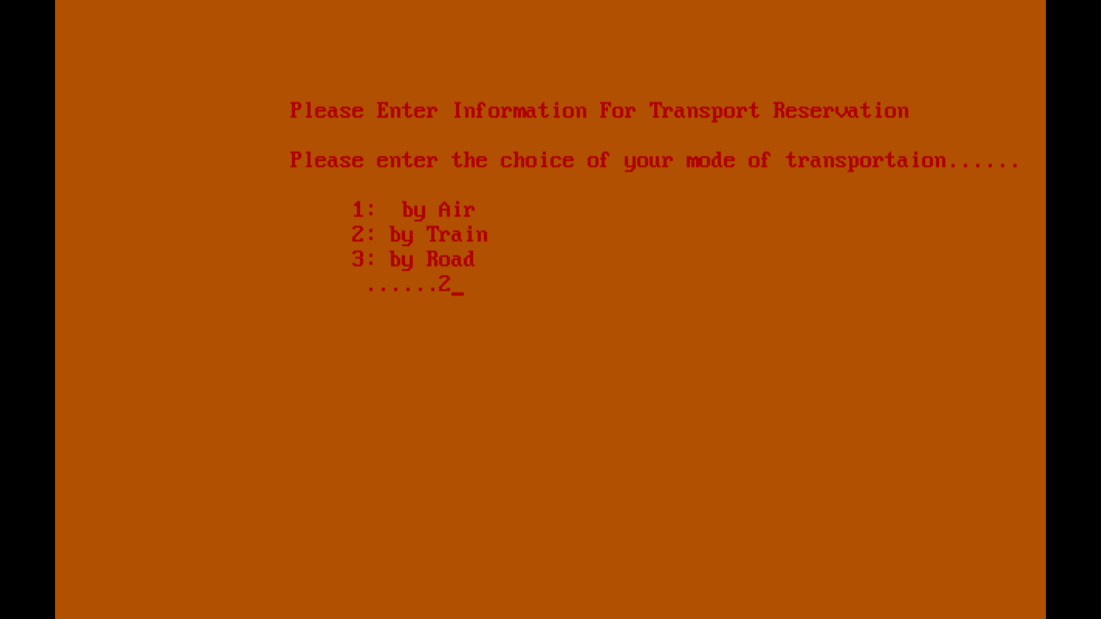
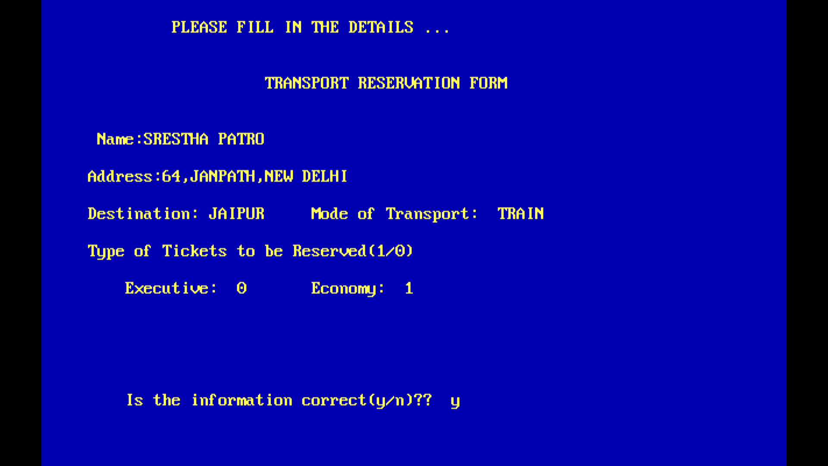

Slide 13
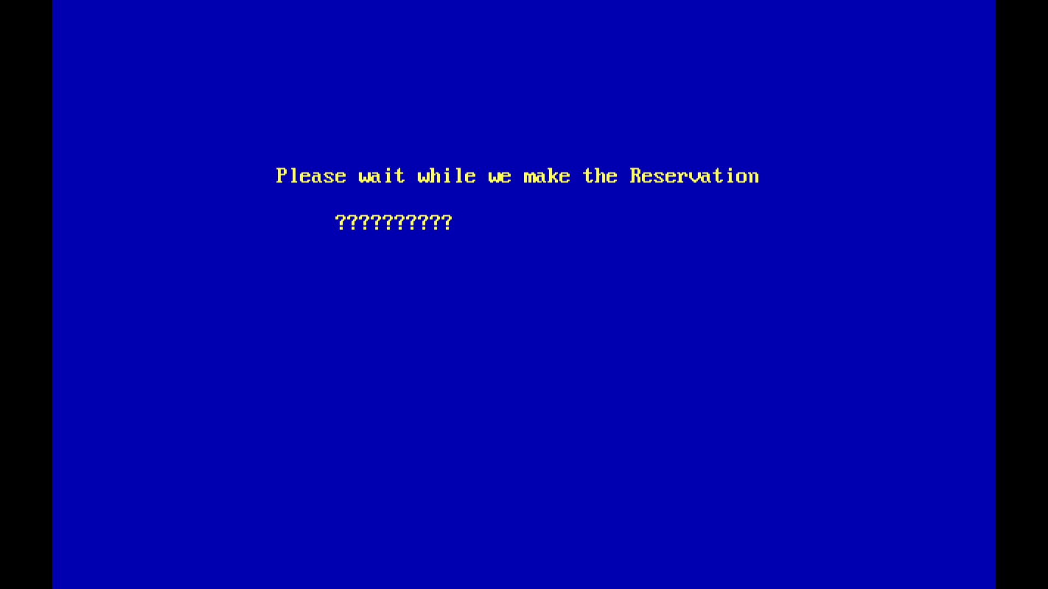
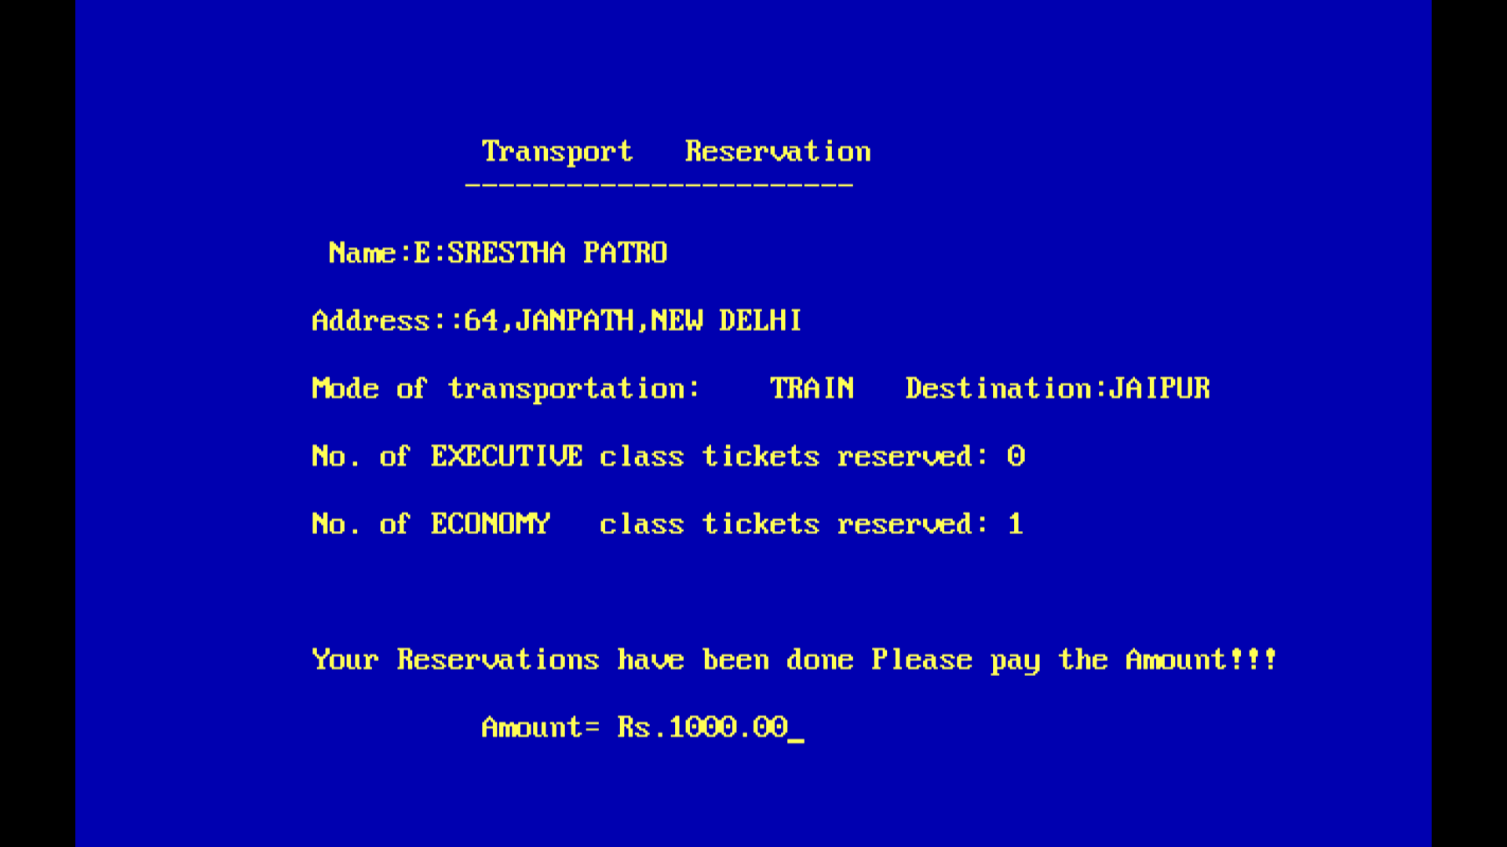

Slide 14

HOME PAGE

Slide 15
FUTURE SCOPE
1.Cost effective: Since the page can also be accessed without internet, so it becomes much more easy for the users to use this as compared to those online travel systems.
2. Easily Accessible: This is a menu driven program and is very user friendly. So it is easy to give inputs and follow the steps and easily complete the process to process . User can also easily retrieve and change the details given .
3. It can be made as a mobile app for platforms Android and IOS.
4. It can be used to solve other similar problems such as flight deals, best university
and so on.
5. It will recommend tour package based on Famous Festivals celebrated across India.
6. Best Hotels in the recommended area can also be included in nearest Destination.
7. Reviews can be taken and added for better experience.

Slide 16
CONCLUSION
The user can select the best package in short amount of time. The user can also book easily without internet and can easily retrieve the details .Finally, the goal of the project is to make an efficient system which is effective in terms of cost and money.

Slide 17

THANK YOU

